Slide 1

PHILIPPINE BUS ASSISTANCE
DRIVER
LOG IN

Slide 2

P.B.A.
DRIVER USERNAME
ADMIN123
PASSWORD
***********
LOG IN

Slide 3

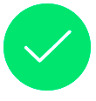
P.B.A.
LOG IN SUCCESS
DRIVER USERNAME
ADMIN123
Align QR Code to the box
PASSWORD
***********
LOG IN

Slide 4







JUAN DELA CRUZ BBL-8901 ABC-123
HOME
HISTORY
EARNINGS
SCAN QR
LOG OUT
BACK
P.B.A.
LOG IN SUCCESS
DRIVER USERNAME
ADMIN123
Align QR Code to the box
PASSWORD
***********
LOG IN

Slide 5

HISTORY
BBL BUENDIA – BBL BALIBAGO
2019 – 09 – 17
V
BBL BALIBAGO – BBL BUENDIA
2019 – 09 – 17
V
BBL BUENDIA – BBL BALIBAGO
2019 – 09 – 16
V
BBL BUENDIA – BBL BALIBAGO
2019 – 09 – 15
V
BBL BALIBAGO – BBL BUENDIA
2019 – 09 – 14
V
BBL BALIBAGO – BBL BUENDIA
2019 – 09 – 13
V

Slide 6
JUAN DELA CRUZ BBL-8901 ABC-123
HOME
HISTORY
EARNINGS
SCAN QR
LOG OUT
BACK
HISTORY
BBL BUENDIA – BBL BALIBAGO
2019 – 09 – 17
V
BBL BALIBAGO – BBL BUENDIA
2019 – 09 – 17
V
BBL BUENDIA – BBL BALIBAGO
2019 – 09 – 16
V
BBL BUENDIA – BBL BALIBAGO
2019 – 09 – 15
V
BBL BALIBAGO – BBL BUENDIA
2019 – 09 – 14
V
BBL BALIBAGO – BBL BUENDIA
2019 – 09 – 13
V

Slide 7
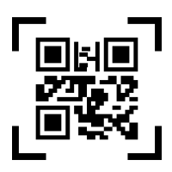

Align QR Code to the box
After payment has been receive wait for an SMS message

Slide 8
JUAN DELA CRUZ BBL-8901 ABC-123
HOME
HISTORY
EARNINGS
SCAN QR
LOG OUT
BACK
Align QR Code to the box
After payment has been receive wait for an SMS message

Slide 9
PAYMENT RECEIVED
Align QR Code to the box
After payment has been receive wait for an SMS message

Slide 10
JUAN DELA CRUZ BBL-8901 ABC-123
HOME
HISTORY
EARNINGS
SCAN QR
LOG OUT
BACK
PAYMENT RECEIVED
Align QR Code to the box
After payment has been receive wait for an SMS message

Slide 11
EARNINGS
PHP 20,000.00
BBL BUENDIA – BBL BALIBAGO
700.00 PHP
BBL BALIBAGO – BBL BUENDIA
1000.00 PHP

Slide 12
JUAN DELA CRUZ BBL-8901 ABC-123
HOME
HISTORY
EARNINGS
SCAN QR
LOG OUT
BACK
EARNINGS
PHP 20,000.00
BBL BUENDIA – BBL BALIBAGO
700.00 PHP
BBL BALIBAGO – BBL BUENDIA
1000.00 PHP

Slide 13
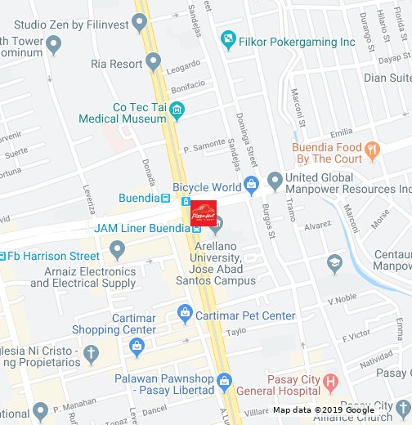
IN TRANSIT
10:00 AM
I HAVE ARRIVED

Slide 14
JUAN DELA CRUZ BBL-8901 ABC-123
HOME
HISTORY
EARNINGS
SCAN QR
LOG OUT
BACK
IN TRANSIT
10:00 AM
I HAVE ARRIVED

Slide 15

PROFILE
JUAN DELA CRUZ
BBL – 9808 | ABC 123
Ride History:
BBL BUENDIA – BBL BALIBAGO
RATING:

Slide 16
JUAN DELA CRUZ BBL-8901 ABC-123
HOME
HISTORY
EARNINGS
SCAN QR
LOG OUT
BACK
PROFILE
JUAN DELA CRUZ
BBL – 9808 | ABC 123
Ride History:
BBL BUENDIA – BBL BALIBAGO
RATING:

Slide 17
SUMMARY
STARTING POINT
BBL BUS TERMINAL – BUENDIA
DESTINATION
BBL BUS TERMINAL - BALIBAGO
LET’S GO!

Slide 18
JUAN DELA CRUZ BBL-8901 ABC-123
HOME
HISTORY
EARNINGS
SCAN QR
LOG OUT
BACK
SUMMARY
STARTING POINT
BBL BUS TERMINAL – BUENDIA
DESTINATION
BBL BUS TERMINAL - BALIBAGO
LET’S GO!

Slide 19
SUMMARY
STARTING POINT
BBL BUS TERMINAL – BUENDIA
DESTINATION
BBL BUS TERMINAL - BALIBAGO
NO. OF PASSENGER SERVED: 60
TOLL FEE: PHP 300.00
TOTAL EARNINGS: PHP 700.00
OK

Slide 20
JUAN DELA CRUZ BBL-8901 ABC-123
HOME
HISTORY
EARNINGS
SCAN QR
LOG OUT
BACK
SUMMARY
STARTING POINT
BBL BUS TERMINAL – BUENDIA
DESTINATION
BBL BUS TERMINAL - BALIBAGO
NO. OF PASSENGER SERVED: 60
TOLL FEE: PHP 300.00
TOTAL EARNINGS: PHP 700.00
OK

Slide 21
PAYMENT SUMMARY
TICKET NUMBER | FARE
2019 – 00001 | PHP 46.00
2019 – 00002 | PHP 36.00
2019 – 00003 | PHP 98.00
2019 – 00004 | PHP 46.00
2019 – 00005 | PHP 46.00
2019 – 00006 | PHP 36.00
2019 – 00007 | PHP 98.00
2019 – 00008 | PHP 46.00
2019 – 00009 | PHP 46.00
2019 – 00010 | PHP 36.00
2019 – 00011 | PHP 98.00
2019 – 00012 | PHP 46.00

Slide 22
JUAN DELA CRUZ BBL-8901 ABC-123
HOME
HISTORY
EARNINGS
SCAN QR
LOG OUT
BACK
PAYMENT SUMMARY
TICKET NUMBER | FARE
2019 – 00001 | PHP 46.00
2019 – 00002 | PHP 36.00
2019 – 00003 | PHP 98.00
2019 – 00004 | PHP 46.00
2019 – 00005 | PHP 46.00
2019 – 00006 | PHP 36.00
2019 – 00007 | PHP 98.00
2019 – 00008 | PHP 46.00
2019 – 00009 | PHP 46.00
2019 – 00010 | PHP 36.00
2019 – 00011 | PHP 98.00
2019 – 00012 | PHP 46.00

